Slide 1


MICRO PROJECT PRESENTATION

Slide 2
Sign Language Detection using Deep Learning

Slide 3
ABSTRACT
Speech impaired people use hand signs and gestures to communicate.
Normal people face difficulty in understanding their language. Hence there is a need of a system which recognizes the different signs, gestures and conveys the information to the normal people. It can bridge the gap between physically challenged people and normal people.

Slide 4
Project goal
So, by this project we are trying to reduce the communication gap between normal and impaired peoples.
We intend to make this project for sign language detection more accessible and easy to use.
We intend to remove the physical equipment and make this project completely software based to make it easy to deploy.

Slide 5
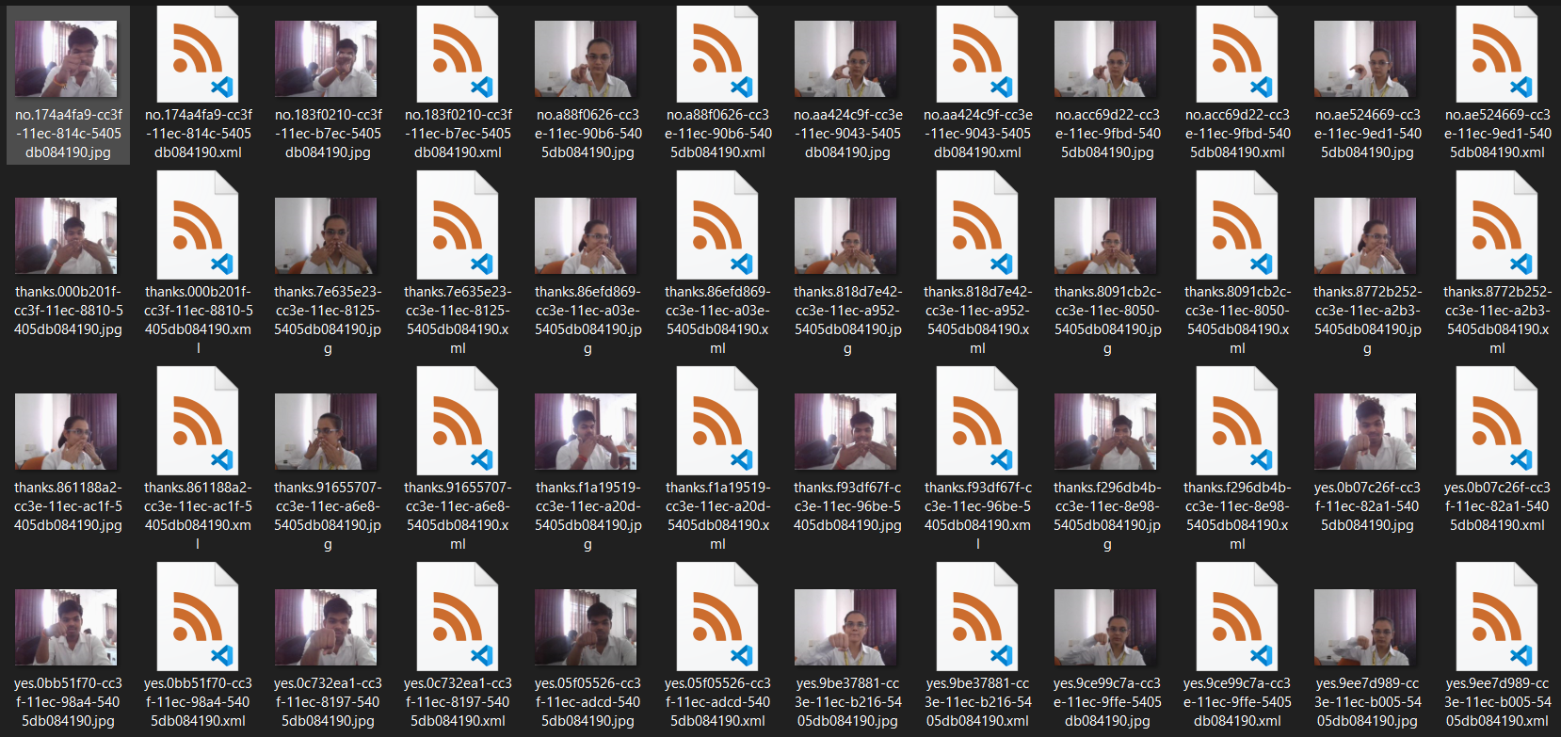
The workflow of our project
First we create a dataset of images for the signs to be detected.

Slide 6
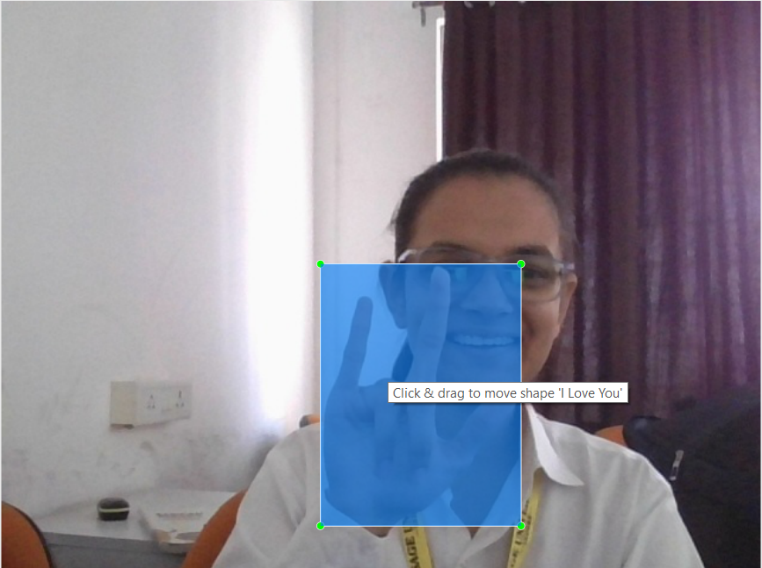
We label the dataset with the corresponding sign.

Slide 7
We train the neural network on the labelled dataset.
We then proceed to use TensorFlow and OpenCV libs to initiate the sign language detection.

Slide 8
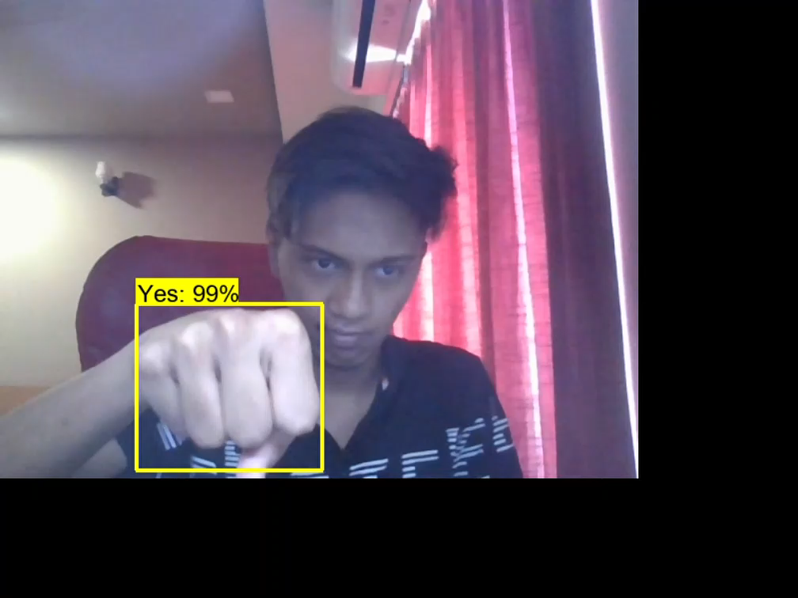

Slide 9
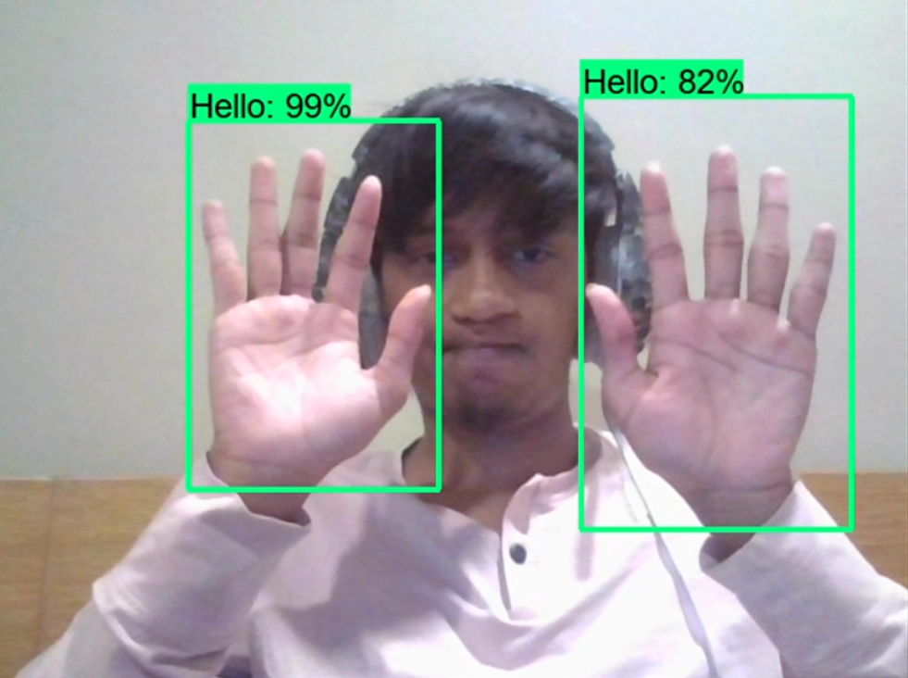
What we have currently achieved
The detection we provide is in real time.
We can detect multiple signs simultaneously.

Slide 10
What we have currently achieved
We can easily add more signs in data set for detection.
The detection is labelled so it is easy to identify.
High Accuracy can be achieved by just adding the artifacts to the dataset.
Lag free and smooth detection using CUDA library.

Slide 11
What we intend to achieve
We intend to remove the noise and make the detection more stable.
We intend to decrease the performance impact of the model
We intend to make it as a stand-alone application.
We intend to deploy it on mobile platform.
We intend to make it able to translate sign language tool.

Slide 12
Thank you
Vidhi Patel
Anuj Kesharwani
Achyut Verma
AI 4th SEMESTER

